Slide 1
MANTIS
Minimalist Alert Network for Threat Intelligence System
Final Dissertation Presentation
Final Dissertation | CSY4022
Anuskar Sigdel | 24812606
Supervisor: Nischal Khadka | University of Northampton | August 2026
Notes:
[Sources]
- MANTIS_Final_Dissertation_FINAL_BACKUP_CURRENT_SAVED_STATE_2026-08-22_160017.docx, cover page and Chapter 1

Slide 2
1. Introduction: Background and Rationale
Why a transparent low-footprint detector is needed on commodity Linux
• Small Linux servers, IoT gateways and teaching hosts face scans, floods, malicious payloads and known-bad sources under limited resources.
• Signature tools recognise documented attacks, while broader platforms can bring rule, service and infrastructure overhead.
• High laboratory accuracy alone does not prove operational suitability because traffic distribution, latency and resource use can change.
• MANTIS investigates whether five understandable methods can operate together without external Python runtime packages.
• Every alert retains visible features, thresholds or learned state so an administrator can review why it was raised.
2
Notes:
[Sources]
- MANTIS_Final_Dissertation_FINAL_BACKUP_CURRENT_SAVED_STATE_2026-08-22_160017.docx, Sections 1.1 and 1.2

Slide 3
2. Aim and Objectives
One aim supported by six measurable and testable objectives
• Aim: design, implement and critically evaluate a transparent, low-footprint host NIDS for commodity Linux using no external Python runtime packages.
• Specify traceable detection, persistence and response requirements with acceptance evidence.
• Implement five inspectable engines behind one analyse, train and brain-state contract.
• Integrate live or PCAP capture, parsing, bounded queues, alerts, SIEM evidence and policy-gated response.
• Validate training data and evaluate software behaviour separately from wider detection accuracy.
• Compare MANTIS with Snort, Suricata, Zeek and Wazuh while stating Linux, plaintext and laboratory limits.
3
Notes:
[Sources]
- MANTIS_Final_Dissertation_FINAL_BACKUP_CURRENT_SAVED_STATE_2026-08-22_160017.docx, Section 1.3 and Table 1.1

Slide 4
3. Requirements: Problem and Solutions
Requirement engineering links the problem domain to a justified implementation choice
Engineering option | Why it was considered | Decision for MANTIS
Problem domain | Constrained Linux hosts need explainable monitoring | Five complementary transparent methods
Proposed solution | One compact capture-to-response workflow | Python Standard Library prototype
Snort / Suricata extension | Mature packet inspection | Not selected: shifts work to external engine integration
ML framework | Faster access to complex models | Not selected: adds dependencies and hides first-principles logic
Wazuh deployment | Broad endpoint management and response | Not selected: wider and heavier than the single-host research aim
• The selected strategy is justified for the dissertation aim, not presented as the best choice for every deployment.
4
Notes:
[Sources]
- MANTIS_Final_Dissertation_FINAL_BACKUP_CURRENT_SAVED_STATE_2026-08-22_160017.docx, Sections 2.8.1 to 2.8.3 and Table 2.5

Slide 5
4. Functional and Non-Functional Requirements
Required behaviours are paired with operational qualities and safety constraints
• Functional: capture live Ethernet or finite PCAP input, parse supported protocols and continue safely past malformed frames.
• Functional: run five engines through a common Verdict, train applicable models and persist compatible JSON brain state.
• Functional: construct auditable alerts, publish local SIEM data, export evidence and gate iptables response through explicit policy.
• Non-functional: preserve transparency, Standard Library portability, modular maintainability and reproducible configuration and test evidence.
• Non-functional: bound queues and retention, redact sensitive content, disable defence by default and handle failures without terminating analysis.
5
Notes:
[Sources]
- MANTIS_Final_Dissertation_FINAL_BACKUP_CURRENT_SAVED_STATE_2026-08-22_160017.docx, Sections 2.8.4 and 2.8.5; Tables 2.6 and 2.7

Slide 6
Literature Review
Notes:
[Sources]
- MANTIS_Final_Dissertation_FINAL_BACKUP_CURRENT_SAVED_STATE_2026-08-22_160017.docx, Chapter 2 literature review

Slide 7
Literature Review: Recent Evidence
Report papers ordered from newest to oldest
2024 | Halvorsen et al. | Applying Generative Machine Learning to Intrusion Detection: A Systematic Mapping Study and Review
Keywords | generative ML, scarce data, class imbalance, fidelity metrics, deployment gap.
MANTIS link | motivated transparent edge detection with measurable runtime evidence.
2023 | Neto et al. | CICIoT2023: A Real Time Dataset and Benchmark for Large Scale Attacks in IoT Environment
Keywords | 105 IoT devices, 33 attacks, benchmark dataset, schema validation.
MANTIS link | provided external data, while MANTIS validates engine-native features and separates prepared records from raw capture.
7
Notes:
[Sources]
- MANTIS_Final_Dissertation_FINAL_BACKUP_CURRENT_SAVED_STATE_2026-08-22_160017.docx, Chapter 2 Sections 2.1.1 and 2.1.2, plus the corresponding reference entries

Slide 8
Literature Review: Key Comparisons
The remaining report papers continue in descending year order
2023 | Hidayat et al. | Machine Learning Based Intrusion Detection System: An Experimental Comparison
Keywords | TON_IoT, KNN, model comparison, multiple metrics, computational cost.
MANTIS link | supported a scan-focused KNN engine and per-engine evaluation rather than one universal classifier.
2022 | Kus et al. | A False Sense of Security? Revisiting the State of Machine Learning Based Industrial Intrusion Detection
Keywords | withheld attacks, generalisation failure, inflated random-split accuracy, unknown attacks.
MANTIS link | kept software test passes separate from field accuracy and framed K-Means as novelty detection, not proven zero-day detection.
8
Notes:
[Sources]
- MANTIS_Final_Dissertation_FINAL_BACKUP_CURRENT_SAVED_STATE_2026-08-22_160017.docx, Chapter 2 Sections 2.1.3 and 2.1.4, plus the corresponding reference entries

Slide 9
5. Methodology
Constructive research builds, evaluates and critiques one traceable artefact
• Requirements were derived from literature, comparable systems and the constrained Linux deployment context.
• The artefact was constructed, evaluated against those requirements and then critiqued within its tested boundaries.
• Pragmatism selected evidence appropriate to the question: mathematical inspection, automated tests, metrics and architectural review.
• Quantitative evidence includes test outcomes and per-engine confusion-matrix metrics; qualitative evidence is limited to structured usability and design critique.
• Dataset origin, preprocessing, configuration, environment and commands are reported so claims remain reproducible and bounded.
9
Notes:
[Sources]
- MANTIS_Final_Dissertation_FINAL_BACKUP_CURRENT_SAVED_STATE_2026-08-22_160017.docx, Sections 2.3, 2.4 and 2.6

Slide 10
6. Agile, Scrum and Kanban
How the methodology was implemented during construction
Agile | Incremental build-and-verify cycles refined thresholds, feature contracts and dataset mappings.
Scrum | Backlog, review and adaptation ideas were used without full solo-project ceremonies.
Kanban | Work in progress was limited to two coding cards and one testing card.
Evidence | Every card named a module, acceptance test and evidence file.
Feedback | Failed evaluation returned work to In Progress until evidence and implementation aligned.
10
Notes:
[Sources]
- MANTIS_Final_Dissertation_FINAL_BACKUP_CURRENT_SAVED_STATE_2026-08-22_160017.docx, Sections 1.4.1 and 2.5

Slide 11
7. Algorithm Definitions and Roles
Each method targets a different observable threat pattern
Engine | Definition | Used for | MANTIS input
Z-Score | Deviation from an online mean | Volumetric flood anomaly | Packets per second
KNN | Vote of nearest labelled vectors | Port-scan behaviour | Packet count and unique ports
Naive Bayes | Token class probability | Malicious plaintext payload | Privacy-limited tokens
K-Means | Distance from learned centroids | Behavioural novelty | PPS and unique ports
Bloom Filter | Probabilistic set membership | Known-bad source reputation | Source IP
• Five distinct decision methods feed one common Verdict contract.
11
Notes:
[Sources]
- MANTIS_Final_Dissertation_FINAL_BACKUP_CURRENT_SAVED_STATE_2026-08-22_160017.docx, Sections 2.9 and 3.6

Slide 12
8. Engine Implementation
Definitions become explicit state, calculations and decision rules in the system
Engine | Implementation | Stored state | Decision rule
Z-Score | Welford online mean and variance | Count, mean and M2 | Alert when |z| > 3 after warm-up
KNN | Scaled Euclidean distance and k=3 vote | Labelled vectors | Majority label plus vote confidence
Naive Bayes | Token priors and smoothed likelihoods | Class and token counts | Malicious class above threshold
K-Means | Online mini-batch centroid update | Centroids and counts | Distance threshold; anomalies withheld
Bloom Filter | Fixed bit array with multiple hashes | Bits and feed metadata | Membership hit for source IP
Training and compatible state are exported to a readable JSON brain and restored at startup.
12
Notes:
[Sources]
- MANTIS_Final_Dissertation_FINAL_BACKUP_CURRENT_SAVED_STATE_2026-08-22_160017.docx, Sections 2.9, 3.6 and 4

Slide 13
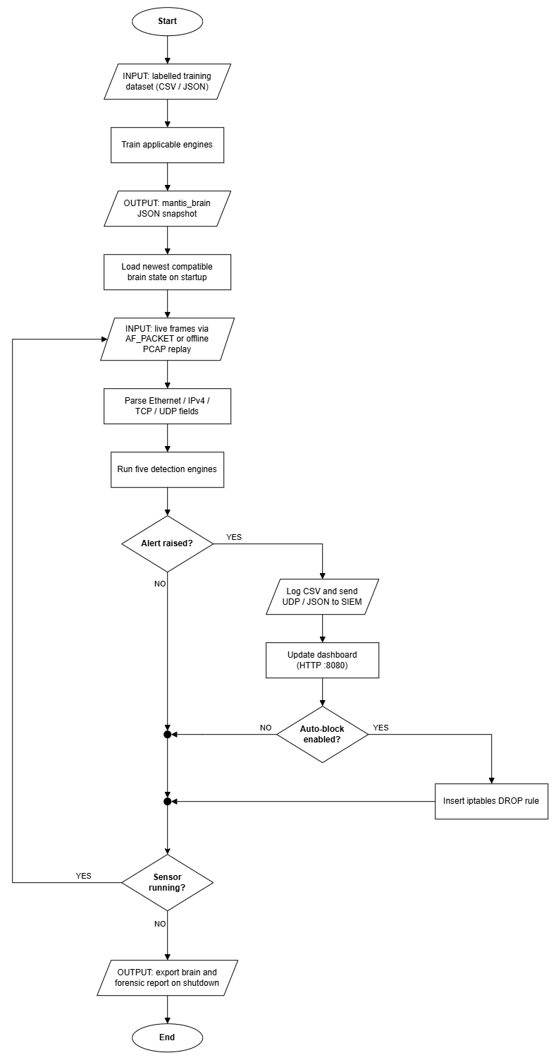
9. System Analysis: Workflow
Capture, detection, evidence and optional response operate as one bounded path
• Labelled data trains supported engines and exports compatible brain state.
• Live AF_PACKET frames or PCAP replay pass through one validated parser.
• Five engines emit Verdict objects to one dispatcher for logs, SIEM and dashboard evidence.
• Blocking remains disabled unless policy enables it; shutdown exports state and the forensic report.
13
Notes:
[Sources]
- MANTIS_Final_Dissertation_FINAL_BACKUP_CURRENT_SAVED_STATE_2026-08-22_160017.docx, Section 2.8.7 and Figure 2.8 embedded image extracted directly from the report

Slide 14
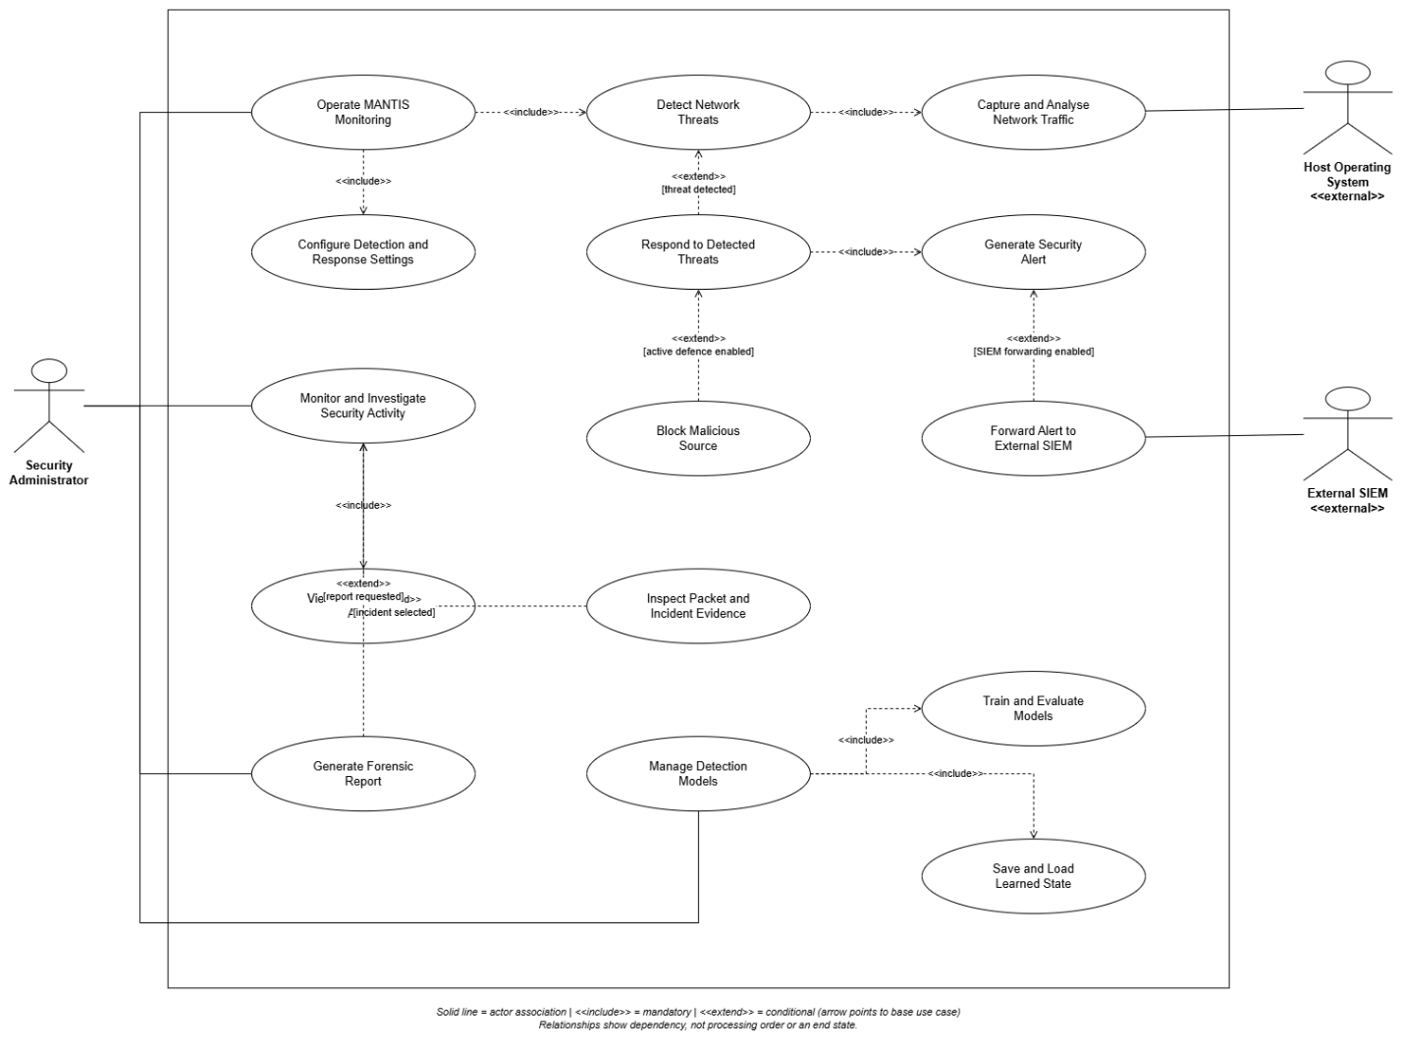
10. System Design: Use Cases
Mandatory monitoring is separated from conditional active defence
14
Notes:
[Sources]
- MANTIS_Final_Dissertation_FINAL_BACKUP_CURRENT_SAVED_STATE_2026-08-22_160017.docx, Section 3.1, Figure 3.1b and Tables 3.1 to 3.2

Slide 15
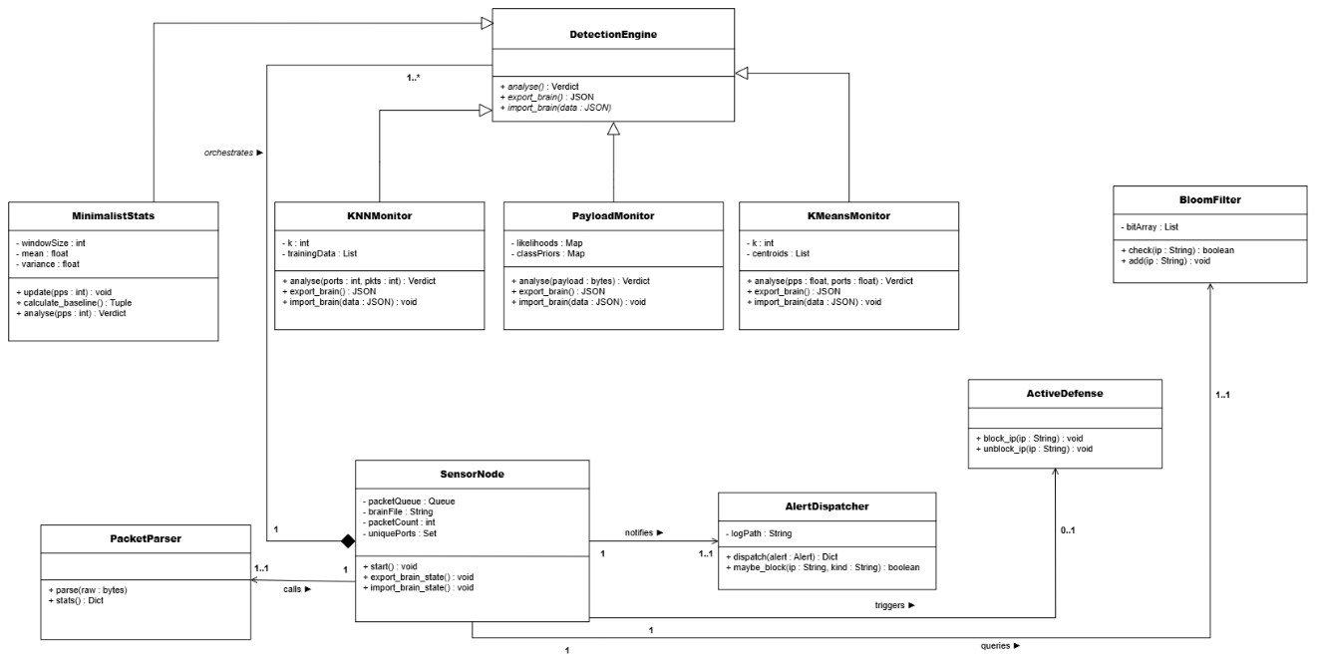
11. System Design: Class Model
Inheritance, composition and multiplicities show component ownership
15
Notes:
[Sources]
- MANTIS_Final_Dissertation_FINAL_BACKUP_CURRENT_SAVED_STATE_2026-08-22_160017.docx, Section 3.3 and Figure 3.3 embedded image extracted directly from the report

Slide 16
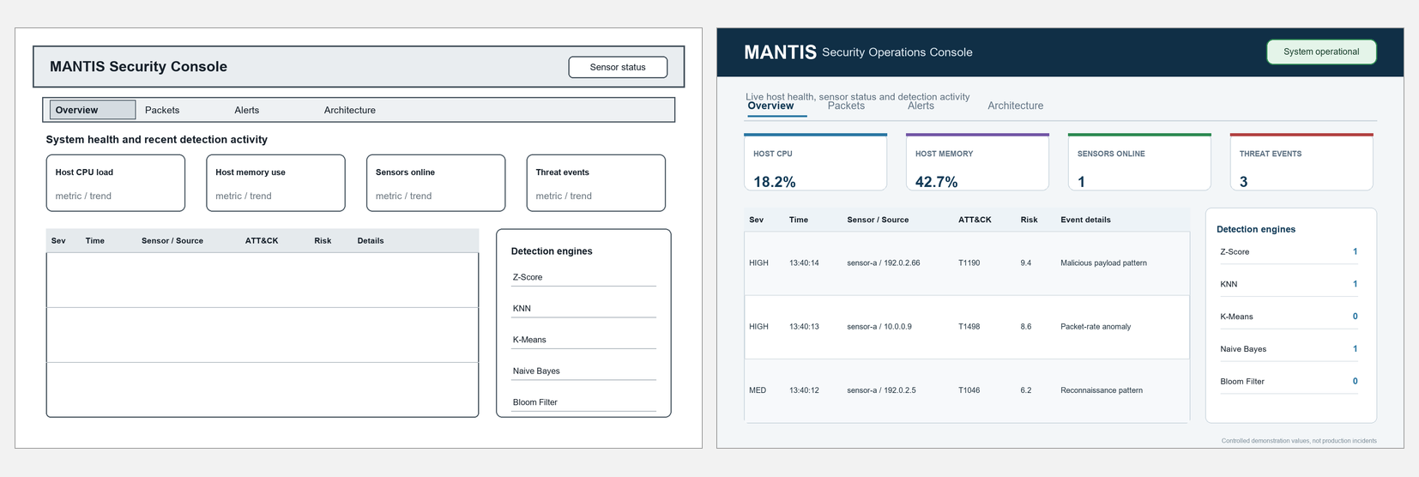
Interface Design: Overview
Left: low-fidelity wireframe | Right: implemented mock-up
16
Notes:
[Sources]
- MANTIS_Final_Dissertation_FINAL_BACKUP_CURRENT_SAVED_STATE_2026-08-22_160017.docx, Section 3.7 and Figures 3.7a and 3.8a; both embedded images extracted directly from the exact report

Slide 17
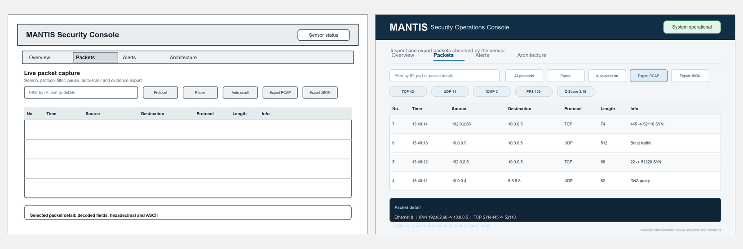
Interface Design: Packets
Left: low-fidelity wireframe | Right: implemented mock-up
17
Notes:
[Sources]
- MANTIS_Final_Dissertation_FINAL_BACKUP_CURRENT_SAVED_STATE_2026-08-22_160017.docx, Section 3.7 and Figures 3.7b and 3.8b; both embedded images extracted directly from the exact report

Slide 18
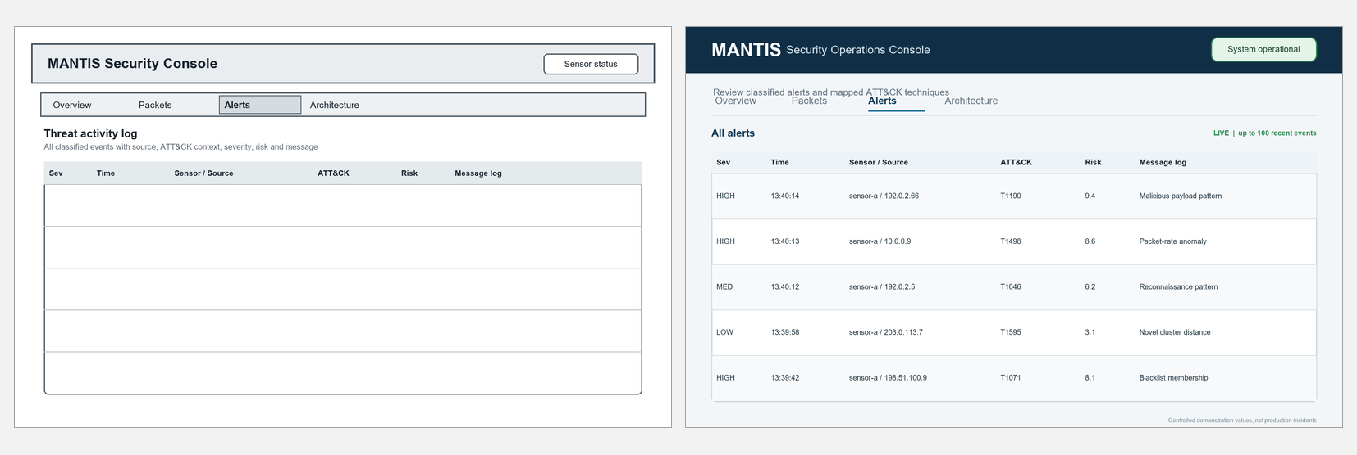
Interface Design: Alerts
Left: low-fidelity wireframe | Right: implemented mock-up
18
Notes:
[Sources]
- MANTIS_Final_Dissertation_FINAL_BACKUP_CURRENT_SAVED_STATE_2026-08-22_160017.docx, Section 3.7 and Figures 3.7c and 3.8c; both embedded images extracted directly from the exact report

Slide 19
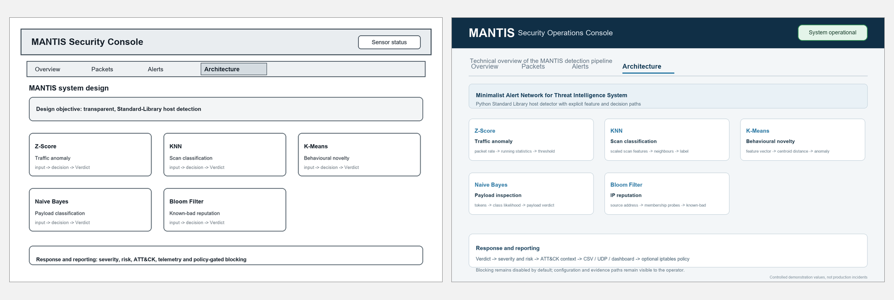
Architecture Interface
Left: low-fidelity wireframe | Right: implemented mock-up
19
Notes:
[Sources]
- MANTIS_Final_Dissertation_FINAL_BACKUP_CURRENT_SAVED_STATE_2026-08-22_160017.docx, Section 3.7 and Figures 3.7d and 3.8d; both embedded images extracted directly from the exact report

Slide 20
Testing 1: Strategy and Unit Tests
Testing verifies specified behaviour before evaluation interprets accuracy
• The repository was re-executed with unittest discovery: 116 tests passed in 4.642 seconds on 20 August 2026.
• The layered strategy covers unit, integration, system, regression and training checks traced to FR and NFR identifiers.
• Unit tests isolate engine mathematics, parser rules, configuration, privacy redaction, PCAP helpers and state serialisation.
• Positive, negative, boundary and failure cases require attacks to be detected, normal input to remain normal and malformed input not to crash.
• Synthetic frames and generated PCAP data make the checks repeatable without attacking an external network.
20
Notes:
[Sources]
- MANTIS_Final_Dissertation_FINAL_BACKUP_CURRENT_SAVED_STATE_2026-08-22_160017.docx, Sections 5.1 and 5.3; Table 5.1

Slide 21
Testing 2: Integration Checks
Internal white-box paths and external black-box behaviour
Integration path | PacketParser to engines, AlertDispatcher, logs, replay and packet storage.
White-box | Truncated-frame handling, scaling, deduplication, redaction and policy branches.
Black-box | CLI, UDP 9999, HTTP 8080, malformed datagrams and PCAP export.
System | Real UDP and HTTP services bind only on loopback during tests.
Firewall | A recording defence object verifies policy without changing the host firewall.
21
Notes:
[Sources]
- MANTIS_Final_Dissertation_FINAL_BACKUP_CURRENT_SAVED_STATE_2026-08-22_160017.docx, Sections 5.1 and 5.3; Tables 5.1 and 5.3

Slide 22
Testing 3: Algorithm-Specific Checks
Each engine is tested according to its own state and failure modes
Z-Score | Warm-up, Welford stability, sustained flood detection and protection against baseline poisoning.
KNN | Scaled features, normal browsing, flood-versus-scan separation and low-volume stealth scans.
K-Means | Warm-up, familiar traffic, novelty distance and withholding anomalous centroid updates.
Naive Bayes | Benign payloads, malicious tokens and the single-token ADMIN safeguard.
Bloom Filter | Feed loading, membership, saturation and the no-false-negative property for inserted indicators.
22
Notes:
[Sources]
- MANTIS_Final_Dissertation_FINAL_BACKUP_CURRENT_SAVED_STATE_2026-08-22_160017.docx, Section 5.2

Slide 23
Results: Algorithm Accuracy
Small domain-matched sets verify implementation, not unrestricted field accuracy
Engine | Samples | Precision | Recall | F1 | MCC
KNN port scan | 40 | 1.0000 | 1.0000 | 1.0000 | 1.0000
Naive Bayes payload | 24 | 1.0000 | 0.9167 | 0.9565 | 0.9199
Z-Score flood | 40 | 1.0000 | 1.0000 | 1.0000 | 1.0000
K-Means novelty | 44 | 1.0000 | 1.0000 | 1.0000 | 1.0000
Bloom reputation | 25 | 1.0000 | 1.0000 | 1.0000 | 1.0000
Naive Bayes missed one of twelve malicious payloads; the other engines were perfect on their small matched samples.
Scores are not directly comparable because each engine uses a separate dataset and decision problem.
23
Notes:
[Sources]
- MANTIS_Final_Dissertation_FINAL_BACKUP_CURRENT_SAVED_STATE_2026-08-22_160017.docx, Section 5.2 and Table 5.2

Slide 24
Results: Dataset Findings
Dataset scale and class balance change how accuracy evidence should be interpreted
Evidence | Size | Key result | Meaning | Limit | Report source
Automated suite | 116 tests | 100% pass | Software behaviour | UDP socket warnings | Chapter 5
Matched engine sets | 173 samples | F1 0.9565 to 1.0000 | Implementation checks | Small separate sets | Table 5.2
PCAP scenario | 13,159 frames | All engines fire | End-to-end replay | Controlled scenario | Abstract
CIC-IoT2023 review | 299,994 rows | Prevalence 0.9761 | Severe imbalance | Not raw packet features | Abstract
Always-positive | Same rows | F1 0.9879 | Headline F1 misleads | Trivial baseline | Abstract
• Heavy-tailed rates violate a fixed three-sigma assumption; the report separates verified implementation from production-accuracy claims.
24
Notes:
[Sources]
- MANTIS_Final_Dissertation_FINAL_BACKUP_CURRENT_SAVED_STATE_2026-08-22_160017.docx, abstract and Chapter 5

Slide 25
Conclusion
• MANTIS meets its aim as a working, inspectable host detector for commodity Linux within the stated laboratory scope.
• Five Standard Library engines share one capture, Verdict, evidence, persistence and optional response pipeline.
• All 116 automated tests passed, and small matched metrics confirm the intended algorithm paths.
• The CIC-IoT2023 re-appraisal shows why prevalence, feature compatibility and algorithm assumptions must remain visible.
• MANTIS is a transparent research prototype, not an enterprise IDS replacement or a claim of unrestricted field accuracy.
Transparent implementation, traceable testing, honest evidence
25
Notes:
[Sources]
- MANTIS_Final_Dissertation_FINAL_BACKUP_CURRENT_SAVED_STATE_2026-08-22_160017.docx, Chapter 7

